Slide 1
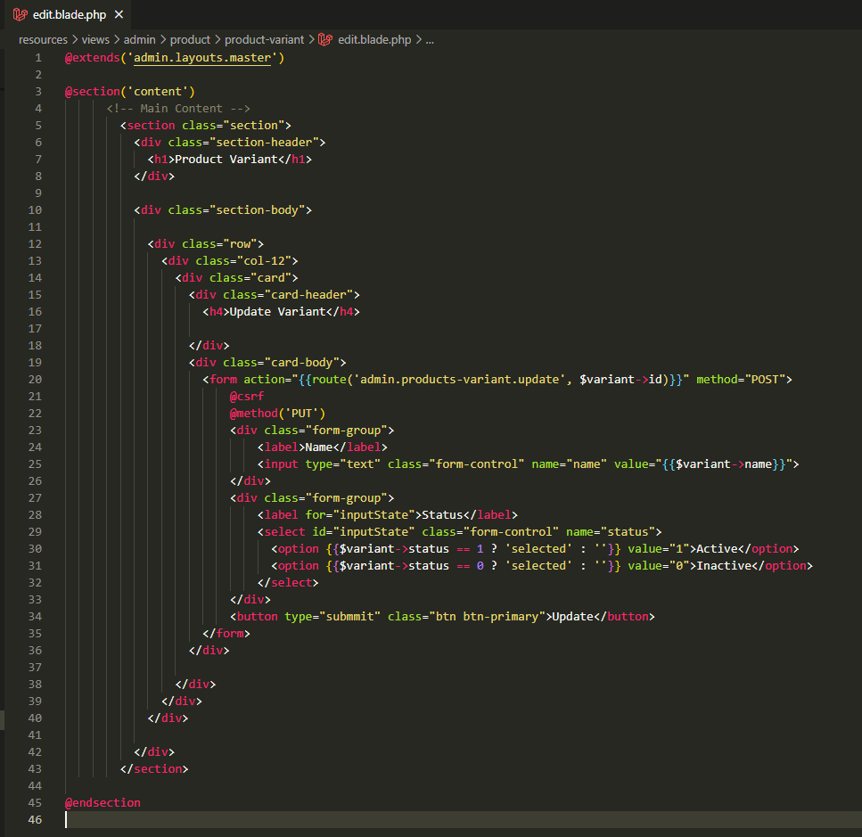
resources\views\admin\product\product-variant\edit.blade.php

Slide 2
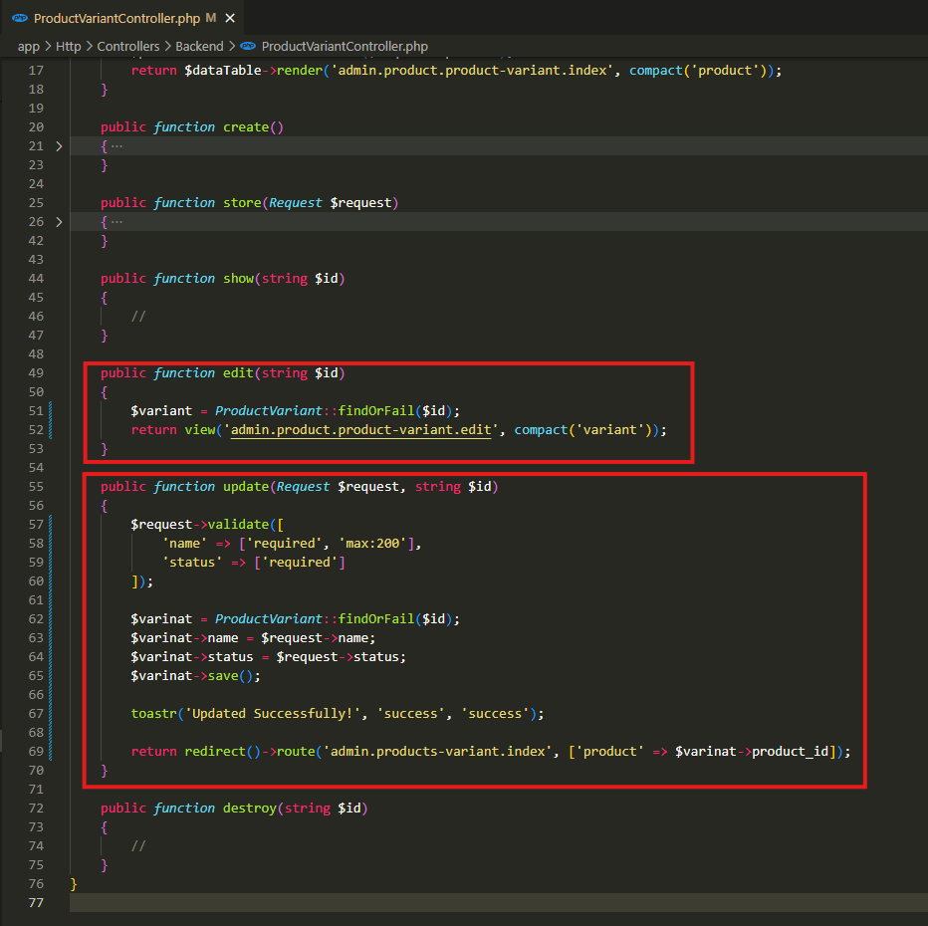
app\Http\Controllers\Backend\ProductVariantController.php

Slide 3
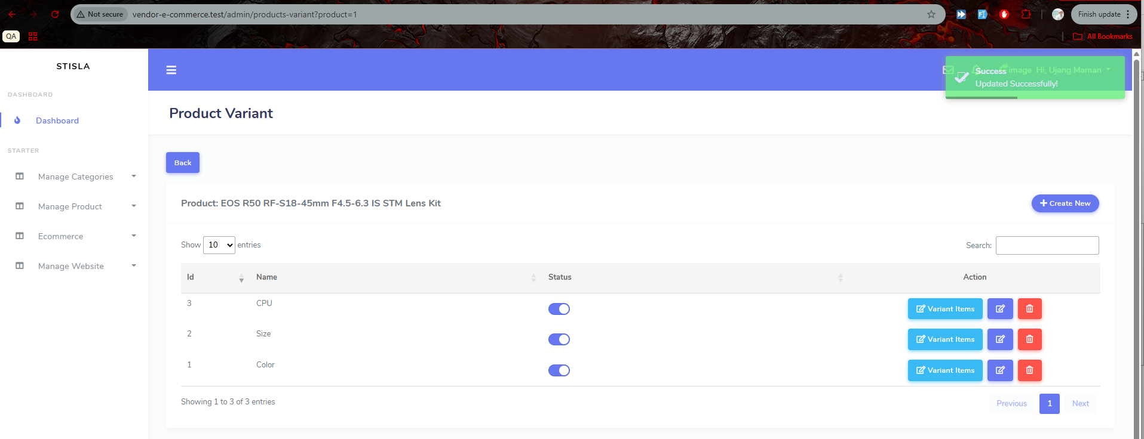
.

Slide 4
.

Slide 5
.

